Slide 1
Purdue Mobile Food Solutions
Database Management System
Group 3 : Andrew Davis, Cameron Raywood, Gianni Frasca, Wilson Huang, Xin Li Leong

Slide 2
Table of Contents
Background
Introduction
Data Modelling : ERD
Relational Data Model : Relational Schema
Database Implementation (SQL CREATE TABLE with foreign key)
SQL Queries

Slide 3
Background
Big data management firm located in West Lafayette, IN
Provides clients with intel on the food truck industry, including:
Supplier information
Location data
Event statistics
Looking to consolidate and improve database to:
Provide increased service quality
Ensure information security for clients

Slide 4
Introduction
Objectives we are focusing on with the improved database:
Accuracy and Accessibility
Security
Scalability
Want to improve service quality

Slide 5
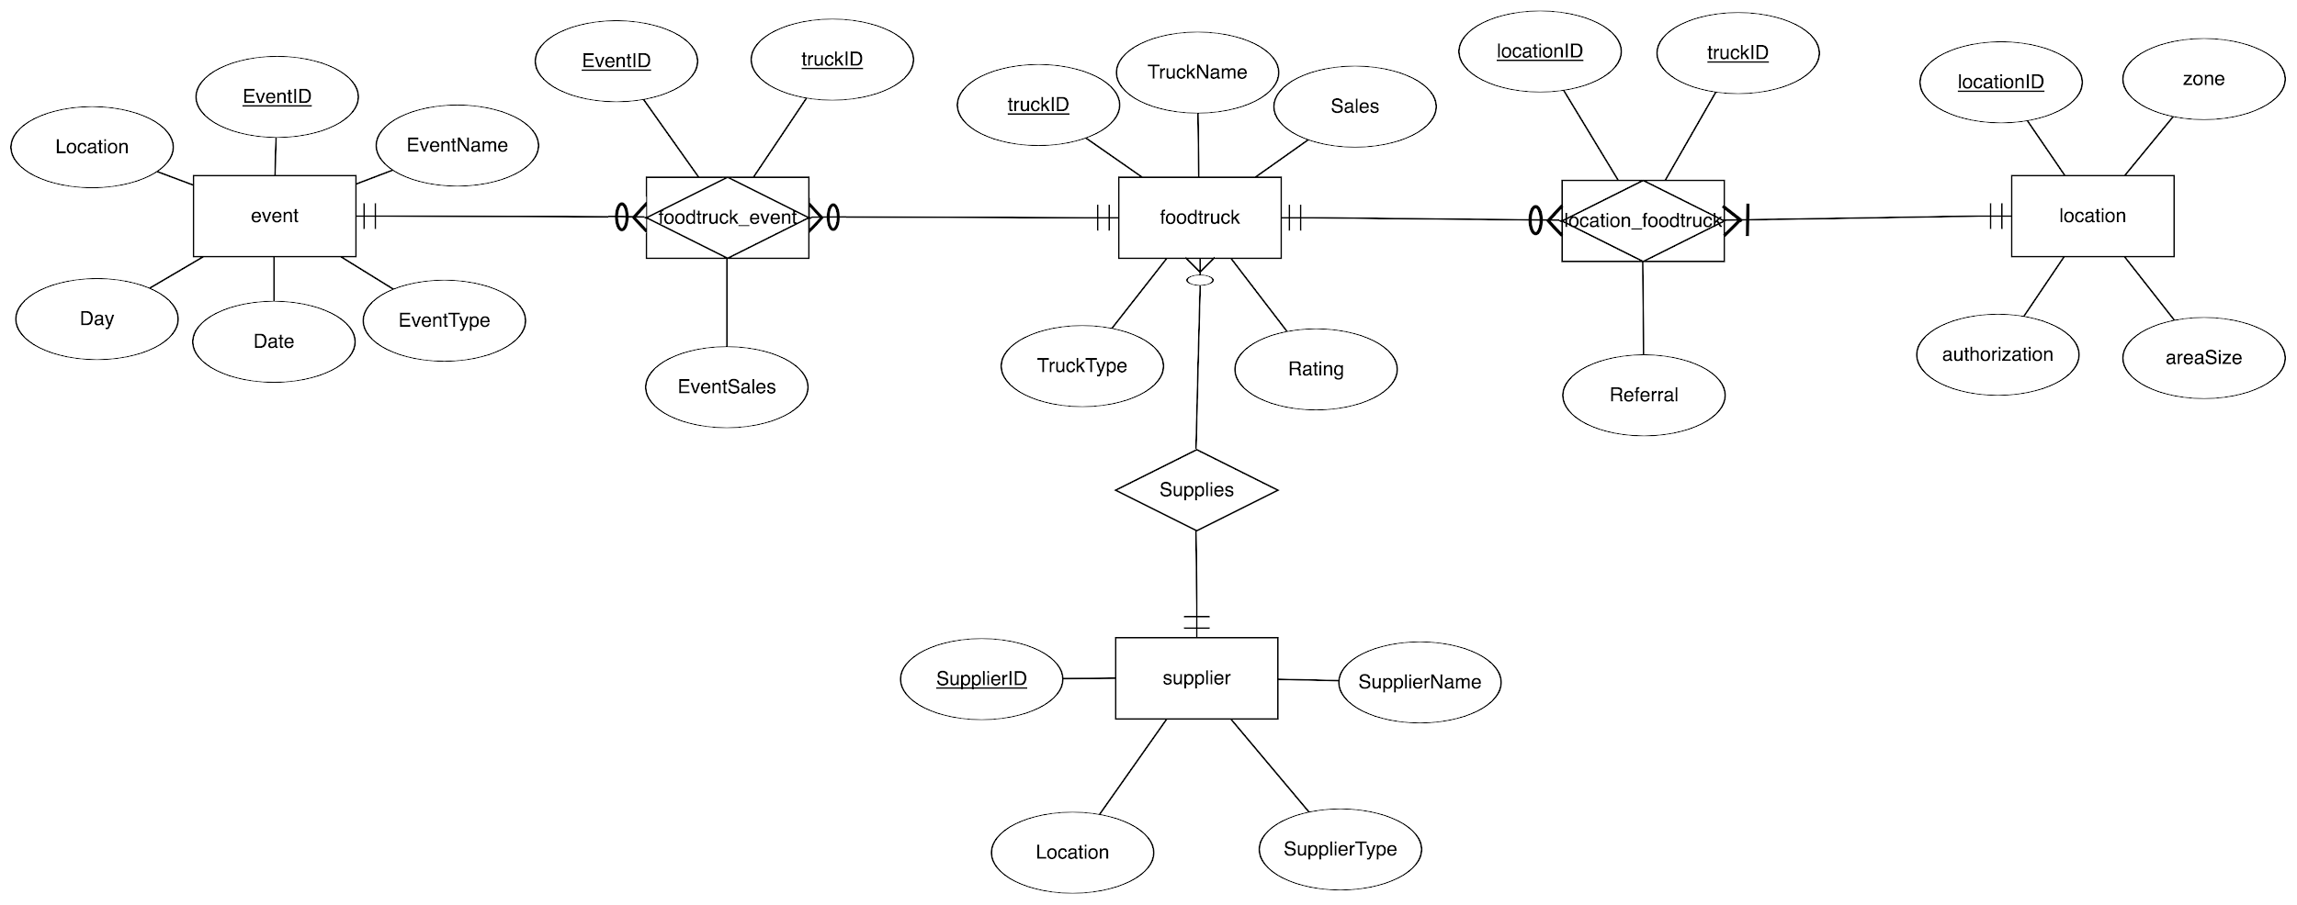
Data Modelling : ERD
Notes:
From our ERD, you can see that we have 4 main entities and 2 associative entities.

Slide 6
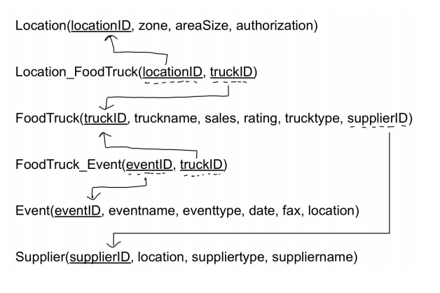
Relational Data Model : Relational Schema

Slide 7
Database Implementation (SQL CREATE TABLE with foreign key)
Entity | Event |  |  |  |  |  | foodtruck_event |  |  | franchiselicense
Column Name | EventID | EventName | EventType | Date | Day | Location | EventID | truckID | EventSales | franchiseID | locationID | truckID | dateissued | expirydate
varchar(20) | / |  |  |  |  |  | / | /
text |  | / | / |  | / | /
datetime |  |  |  | /
int |  |  |  |  |  |  |  |  | /
NOT NULL | / |  |  |  |  |  | / | /
Primary Key | / |  |  |  |  |  | / | /
Foreign Key

Slide 8

SQL Queries
1. After finding the most profitable truck types combined with their average ratings, Purdue Mobile Food Solutions hopes to purchase the most popular and efficient truck types in the future so that budgets will be spent more efficiently in business expansion.
List the most profitable truck type in descending order and provides the average rating for each truck type.
SELECT TruckType, SUM(sales) as Total_Sales, AVG(rating) as AvgRating
FROM Project.foodtruck
GROUP BY TruckType
ORDER BY SUM(SALES) DESC;

Slide 9

SQL Queries (cont.)
2. PMFS wants to figure out the overall area size in which employee authorization is required so that we can plan our business expansion and budget more carefully since such authorization is acquired through negotiations and time-consuming.
List the total area size for zones in which employee authorization is required.
SELECT authorization, zone, SUM(areaSize) as Total_Area_authoriz_by_empl
FROM Project.location
WHERE authorization = "employee"
GROUP BY zone;

Slide 10
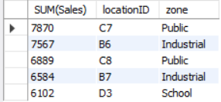
SQL Queries (cont.)
3. In order to save gasoline costs and make investments transit into profits more efficiently, PMFS wants to target some “golden” locations to deploy food trucks in search of more visits, reputation, and sales.
List five most profitable locations to deploy food trucks.
SELECT SUM(Sales),location_foodtruck.locationID,location.zone
FROM foodtruck
INNER JOIN location_foodtruck
ON foodtruck.truckID = location_foodtruck.truckID
INNER JOIN location
ON location_foodtruck.locationID = location.locationID
GROUP BY locationID
ORDER BY sum(Sales) DESC
LIMIT 5;

Slide 11
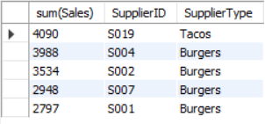
SQL Queries (cont.)
4. Suppliers of PMFS vary in type and scale. It is time to know what its customers like most. With the analyses, PMFS can cut its budgets in purchasing less popular food and focus on cooperating with the most popular and profitable suppliers.
List five suppliers whose food was the most popular.
SELECT sum(Sales),supplier.SupplierID,supplier.SupplierType
FROM foodtruck
INNER JOIN supplier
ON foodtruck.SupplierID = supplier.SupplierID
GROUP BY SupplierID
ORDER BY sum(Sales) DESC
LIMIT 5;

Slide 12

SQL Queries (cont.)
5. Events are great places to increase the popularity and sales of PMFS. However, there have been so many events taking place in this city. PMFS does not have enough employees and budgets to attend all of them. It is strongly recommended that PMFS target the three most profitable event types and gain reputation and sales from them.
List Top 3 event types that incurs the most sales.
SELECT sum(EventSales),EventType
FROM foodtruck
INNER JOIN foodtruck_event
ON foodtruck.truckID = foodtruck_event.TruckID
INNER JOIN Event
ON event.EventID = foodtruck_event.EventID
GROUP BY event.EventType
ORDER BY sum(EventSales) DESC
LIMIT 3;

Slide 13
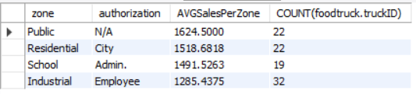
SQL Queries (cont.)
6. To plan budgets and earn profits better, PMFS wants to know which zone has the highest average sales per truck and then compares it to the number of trucks it currently has in that zone to determine if PMFS needs to rearrange the current truck positioning.
Determining which zone has the highest average sales per truck and comparing it to the number of trucks we currently have in that zone to determine if we want to rearrange our current truck positioning.
SELECT location.zone,location.authorization, AVG(foodtruck.sales) AS AVGSalesPerZone, COUNT(foodtruck.truckID)
FROM location
INNER JOIN location_foodtruck
ON location.locationID = location_foodtruck.locationID
INNER JOIN foodtruck
ON location_foodtruck.truckID = foodtruck.truckID
GROUP BY location.zone,location.authorization
ORDER BY AVG(foodtruck.sales) DESC;

Slide 14
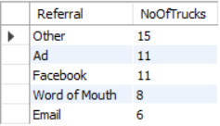
SQL Queries (cont.)
7. Advertisements have been a great method in expanding business and gaining reputation. After knowing the most successful referral methods, PMFS can invest more into that type while cutting budgets on other inefficient referral methods to attract trucks.
Determining which referral method has been most successful in attracting trucks.
SELECT location_foodtruck.Referral,COUNT(foodtruck.truckID) AS NoOfTrucks
FROM foodtruck
INNER JOIN location_foodtruck
ON foodtruck.truckID = location_foodtruck.truckID
WHERE foodtruck.TruckType = "Burger"
GROUP BY location_foodtruck.Referral
ORDER BY COUNT(foodtruck.truckID) DESC;

Slide 15
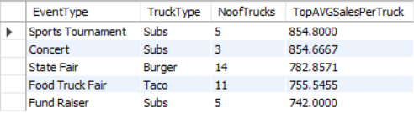
SQL Queries (cont.)
8. PMFS wants to know which truck type performs best in attracting customers and promoting sales during each event so that it can plan more specifically and deploy that truck type more in the incoming events.
List the truck type that has the highest average sales for each event type.
SELECT EventType, TruckType, NoofTrucks, Max(AVGTruckSales) AS TopAVGSalesPerTruck
FROM (
SELECT event.EventType, foodtruck.TruckType,
COUNT(foodtruck.TruckID) AS NoofTrucks,
AVG(foodtruck_event.EventSales) AS AVGTruckSales
FROM event
INNER JOIN foodtruck_event
ON event.EventID = foodtruck_event.EventID
INNER JOIN foodtruck
ON foodtruck.TruckID = foodtruck_event.TruckID
GROUP BY event.EventType, foodtruck.TruckType
ORDER BY event.EventType DESC, AVG(foodtruck_event.EventSales)
DESC
) A
GROUP BY EventType
ORDER BY TopAVGSalesPerTruck DESC;

Slide 16

SQL Queries (cont.)
9. PMFS has received several calls that praised its service in Location B1. Therefore, we want to award employees in this area according to their contributions to sales, which can act as an encouragement to other employees.
List the top 3 highest rated food trucks at Location B1 with the corresponding method of referral.
SELECT foodtruck.TruckName, foodtruck.Rating, location_foodtruck.Referral
FROM foodtruck
INNER JOIN location_foodtruck
ON foodtruck.truckID = location_foodtruck.truckID
WHERE location_foodtruck.locationID="B1"
ORDER BY Rating DESC
LIMIT 3;

Slide 17
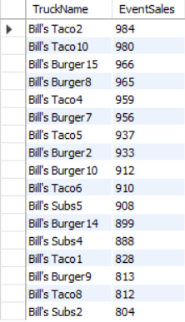
SQL Queries (cont.)
10. It is necessary that PMFS boost sales by encouraging its employees and awarding them accordingly. But first of all, it needs to figure out the sales champions during these months.
List all the food trucks which have event sales greater than $800.
SELECT foodtruck.TruckName, foodtruck_event.EventSales
FROM foodtruck
INNER JOIN foodtruck_event
ON foodtruck.truckID = foodtruck_event.TruckID
GROUP BY foodtruck.TruckName
HAVING foodtruck_event.EventSales>800
ORDER BY foodtruck_event.EventSales DESC;

